Slide 1
UNIT 3
ACTIVITY 3
VIRTUAL STUDENT SST: NOHORA PATRICIA VELASCO SAAVEDRA

Slide 2
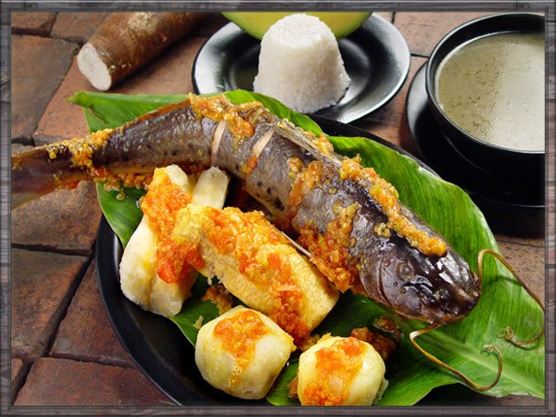
TYPICAL PLATE OF MI FLANDES TOLIMA REGION

Slide 3
Recipe and Method of Preparation
Ingredients:
Bocachico .
Pope
Yucca
Banana hartón
Banana cachaco
Cob
Scallion
Garlic
Colour
Ahuyama
Tomato
Preparation:
The long onion cut into uneven pieces is prepared.
Peel and chop the tomatoes into small pieces.
They peel and chop the garlic, finally.
In a pan add oil, onion, tomato and garlic. It is available for a few minutes and add cumin, salt and color to taste.
In a large saucepan, place the stew with the potatoes, the yucca, the cachaco, the smoke, the cob in pieces, the banana in chips and cook for 30 minutes.
Finally, the fish are added. Cover the pan and let it cook for 10 more minutes.
The consommé is accompanied with avocado and white rice.
Presentation of the dish:
In the banana leaf, the fish are placed in the center, detailed; Around the vegetables, covering them with local sauce. The drink to taste this dish is panela water with lemon.

